Slide 1


MRA Project ML 2 R.BALASUBRAMANIYAM

Slide 2

AGENDA To identify the most popular combos that can be suggested to the Grocery Store chain by analysis of the most commonly occurring sets of menu items in the customer orders.
Contents of the presentation
Problem statement
Exploratory Analysis
Use of Market Basket Analysis
(Association Rules)
Associations Identified
A suggestion of Combos with Lucrative Offers

Slide 3
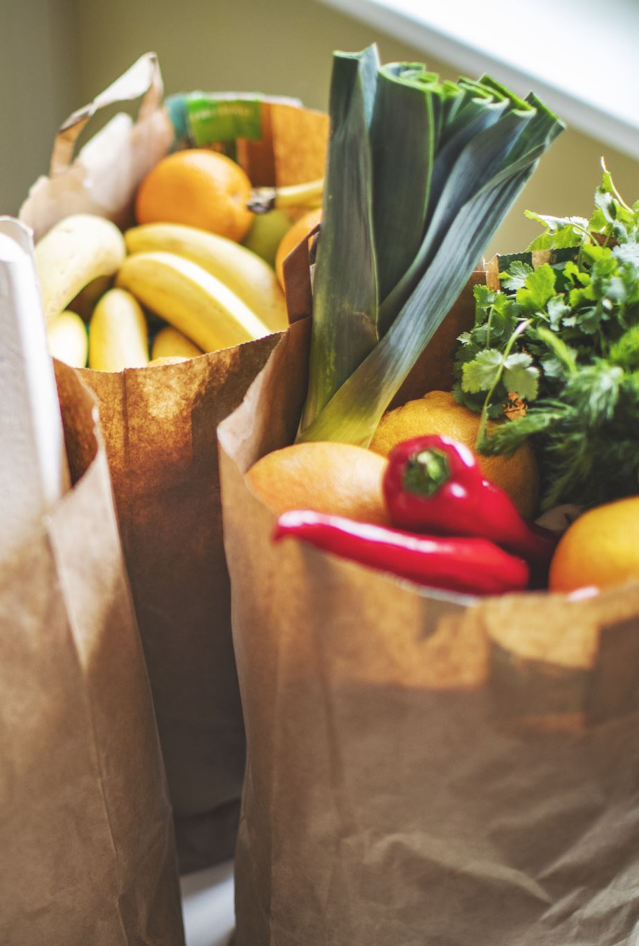
Problem Statement
A Grocery Store shared the transactional data with you. Your job is to identify the most popular combos that can be suggested to the Grocery Store chain after a thorough analysis of the most commonly occurring sets of menu items in the customer orders.
The Store doesn’t have any combo meals. Can you suggest the best combo meals?

Slide 4
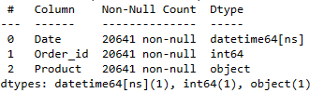
About Data
Data Shape
Data Information
Data Assumptions
No . of. Rows = 20641
No . of. Columns = 3
The features of our dataset are independent.
The data is not having any null values in it.
The date column is having only the first three quarters for 2018,2019 and only the 1st quarter for 2020.

Slide 5


Slide 6

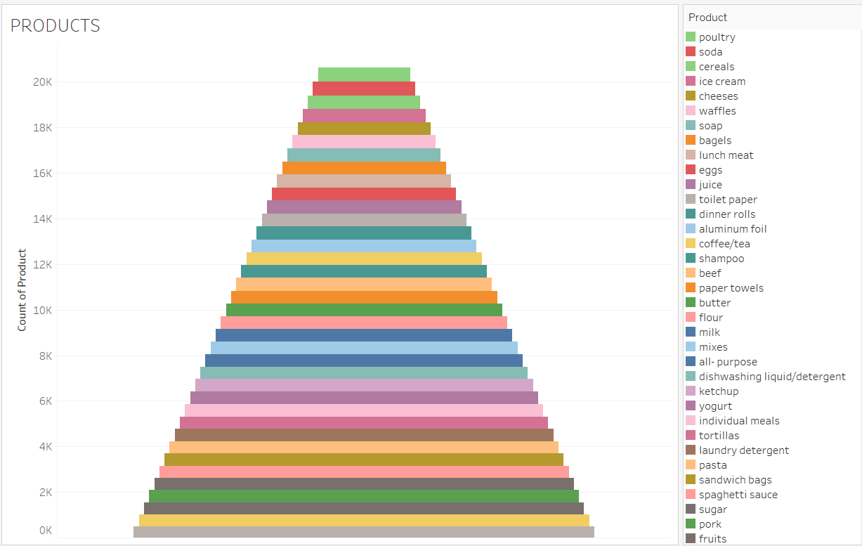



The grocery store sells 37 different products.
Max volume of sales is from poultry products and soap is having min volume of sales
in the product line.
The transaction data is from year 01-01-2018 to
26-02-2020.

Slide 7

Seasonality And Trend Analysis

Slide 8
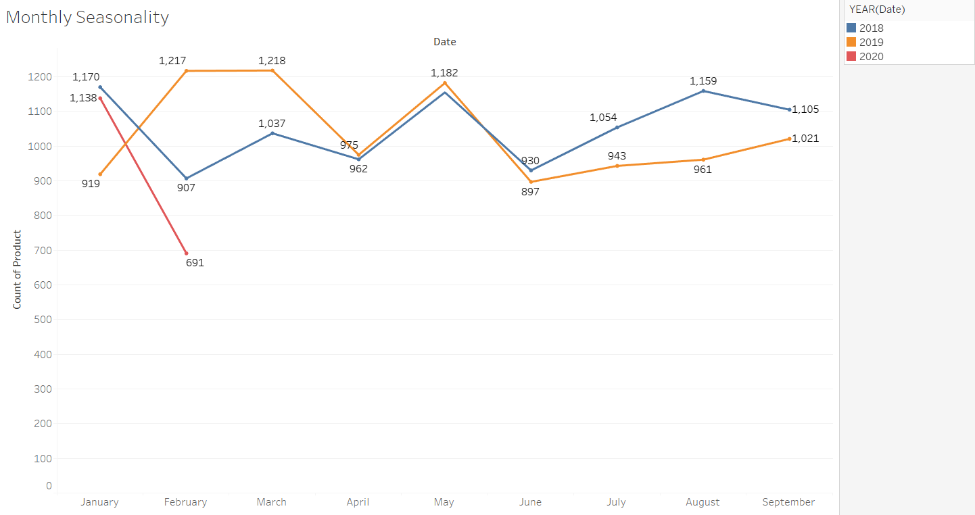
The volume of products sold is decreasing in April month and increases again in May month. The volume again goes down after May till June. After June there is a slight increase in the overall volume of the products sold.
Monthly Seasonality

Slide 9
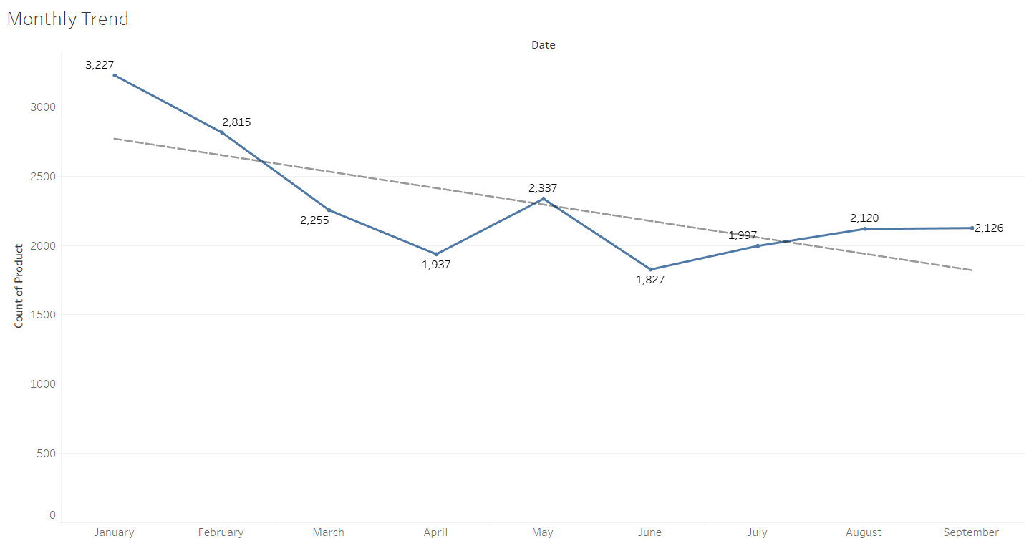
Monthly Trend
The overall volume of products sold by the grocery store is having a downward trend from January till September.
The volume of transactions made by the customers is high in January and declines till April and is lowest in June month.
This indicates the volume of transaction is high in January, February,March,May,September.

Slide 10
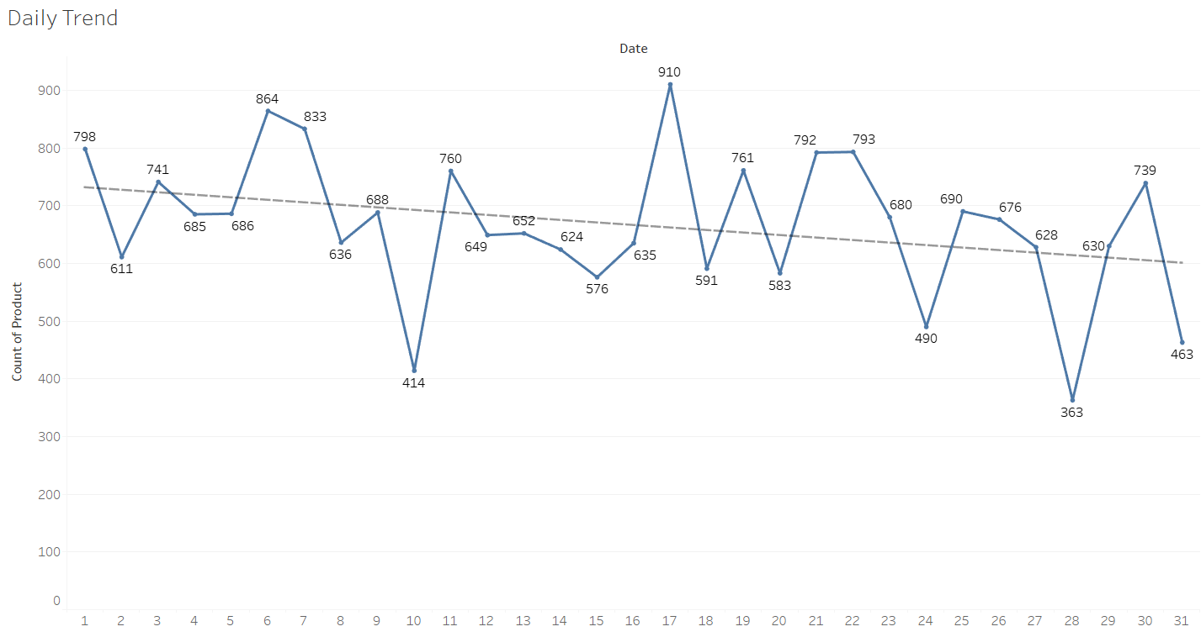
Daily Trend
The volume of transactions made in a month is high in the first 17 days of the month.
In the first 17 days , a greater number of transactions are made in the Day17, and lower number of transactions are made in Day 10.
The overall transaction volume of the grocery store is having a downward trend from Day 1 to Day 31.

Slide 11
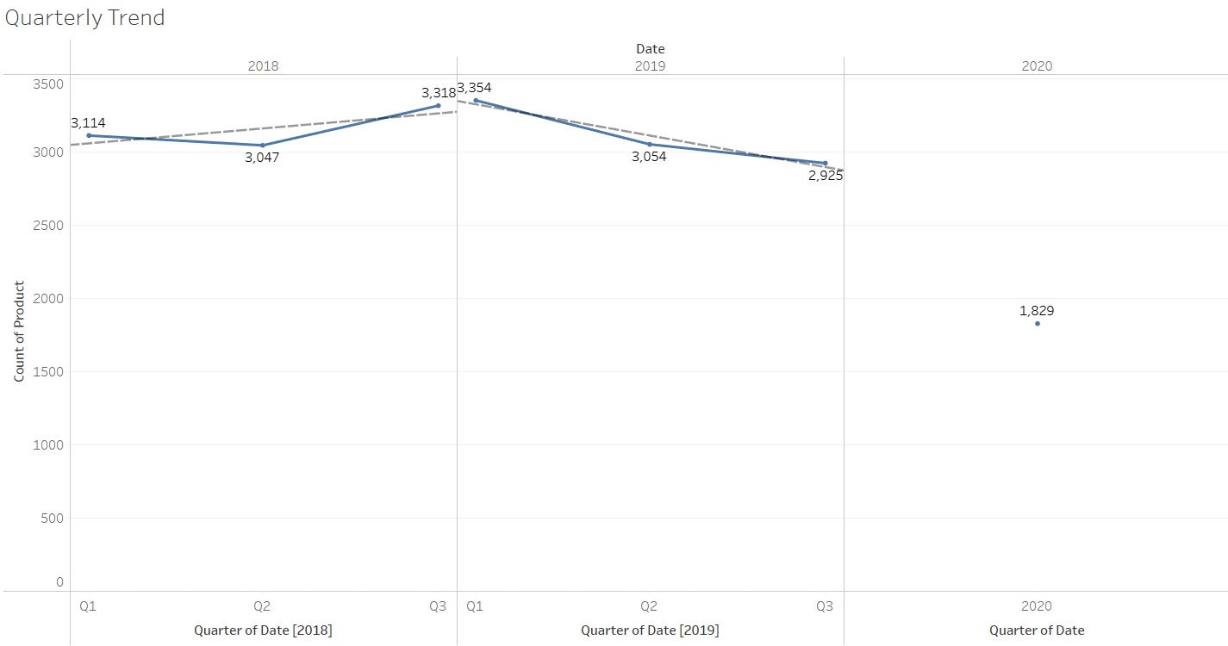
Quarterly Trend
The Q3 of 2018 is having good performance in comparison to its Q1.
2018 has upward quarterly trend.
The Q3 of 2019 is having
lower performance than
the Q1 of same year.
2019 has downward
quarterly trend.
The 2020 year is having only Q1 data, and it is also lower than the Q3 of 2019.

Slide 12
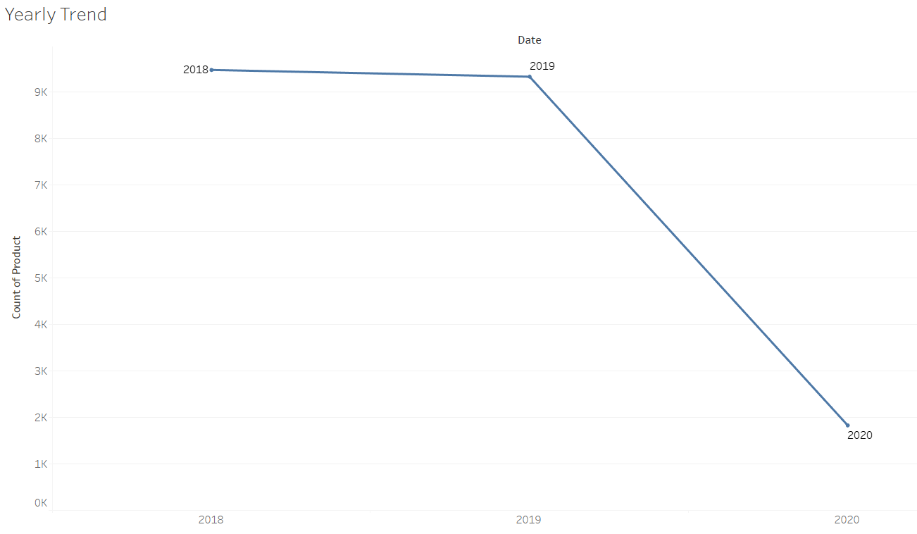
Yearly Trend
The overall transaction volume of the grocery store has reduced significantly from year 2018 to year 2020.
This rapid drop in transaction in 2020-Q1 could be due to the global pandemic(COVID-19).

Slide 13

Market Basket Analysis

Slide 14
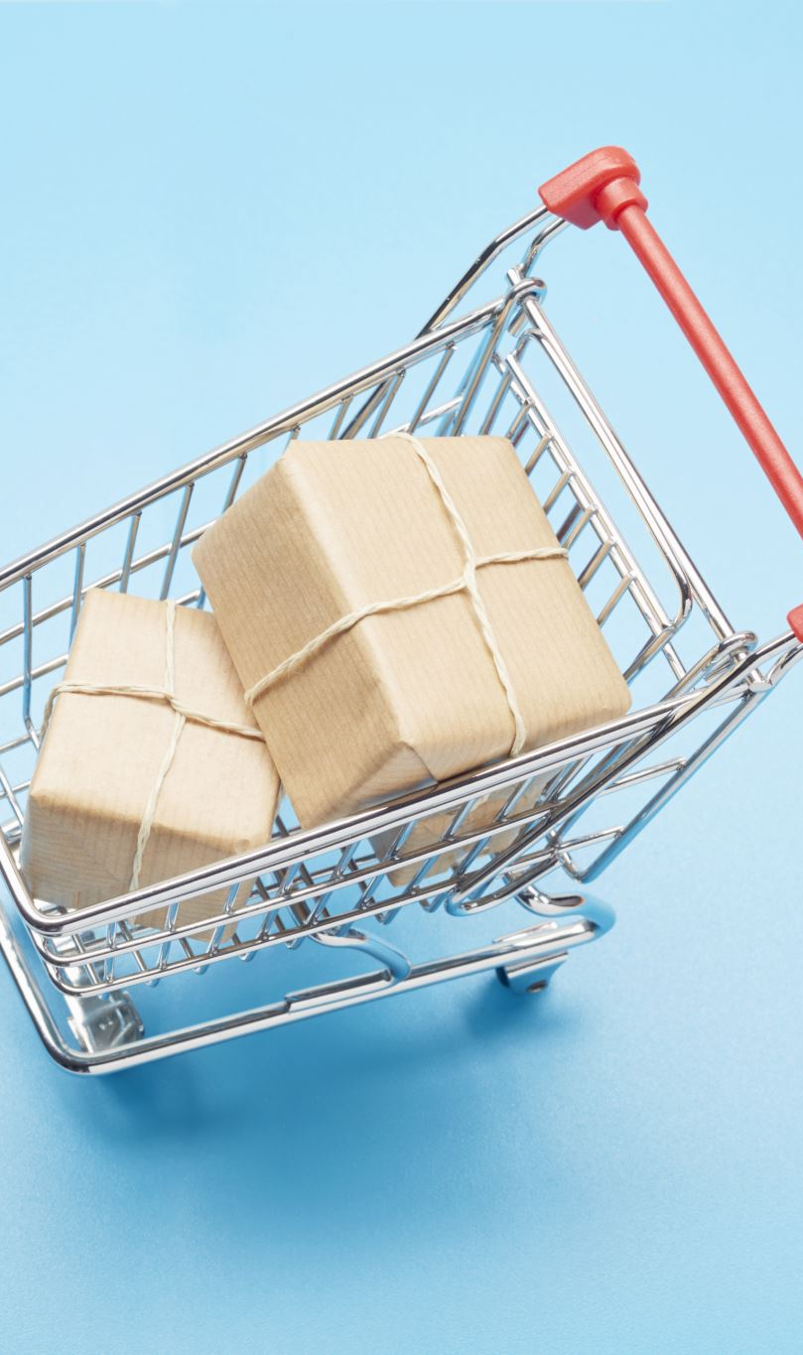
Market Basket Analysis is a technique which identifies the strength of association between pairs of products purchased together and identify patterns of co-occurrence. A co-occurrence is when two or more things take place together.
Market Basket Analysis creates If-Then scenario rules, for example, if item A is purchased then item B is likely to be purchased. The rules are probabilistic in nature, or, in other words, they are derived from the frequencies of co-occurrence in observations.
Frequency is the proportion of baskets that contain the items of interest. The rules can be used in pricing strategies, product placement, and various types of cross-selling strategies.
The antecedent is the condition, and the consequent is the result. The association rule has three measures that express the degree of confidence in the rule, Support, Confidence, and Lift.

Slide 15
Support: (minimum: 0.05)
The first measure called the support is the number of transactions that include items in the {A} and {B} parts of the rule as a percentage of the total number of transactions. It is a measure of how frequently the collection of items occur together as a percentage of all transactions.
Confidence: (minimum: 0.55)
The second measure called the confidence of the rule is the ratio of the number of transactions that include all items in {B} as well as the number of transactions that include all items in {A} to the number of transactions that include all items in {A}.
Lift:
The third measure called the lift or lift ratio is the ratio of confidence to expected confidence. Expected confidence is the confidence divided by the frequency of B. The Lift tells us how much better a rule is at predicting the result than just assuming the result in the first place. Greater lift values indicate stronger associations.
84 rules are created based on the above support and confidence level conditions

Slide 16
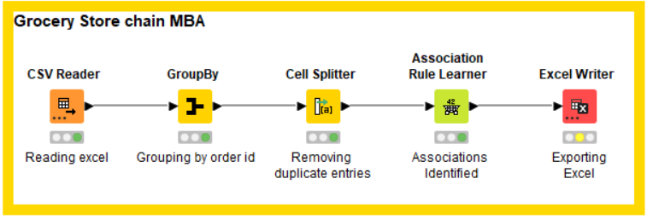
KNIME Workflow

Slide 17
Associations Identified (Top20 based on lift value )

Slide 18
Support, Confidence, & Lift values of Association rule 79 and 17
Based on the data, the rules are created.
Rule 79:
Support says that 5.5% of customers purchased [eggs, ice cream, pasta] and paper towels.
Confidence is that 64.9% of the customers that bought [eggs, ice cream, pasta] also bought paper towels.
Lift represents the 79% increase in expectation that someone will buy paper towels, when we know that they bought [eggs, ice cream, pasta].
The customers could be buying the paper towel to clean the eggs, ice cream, pasta incase they are spilled in their kitchen.
Rule 17:
66% Customers may be expected to buy the sandwich bags when they are purchasing [cheeses, bagels, cereals]. The sandwich bags may be required for packing the sandwich made with cheese.

Slide 19
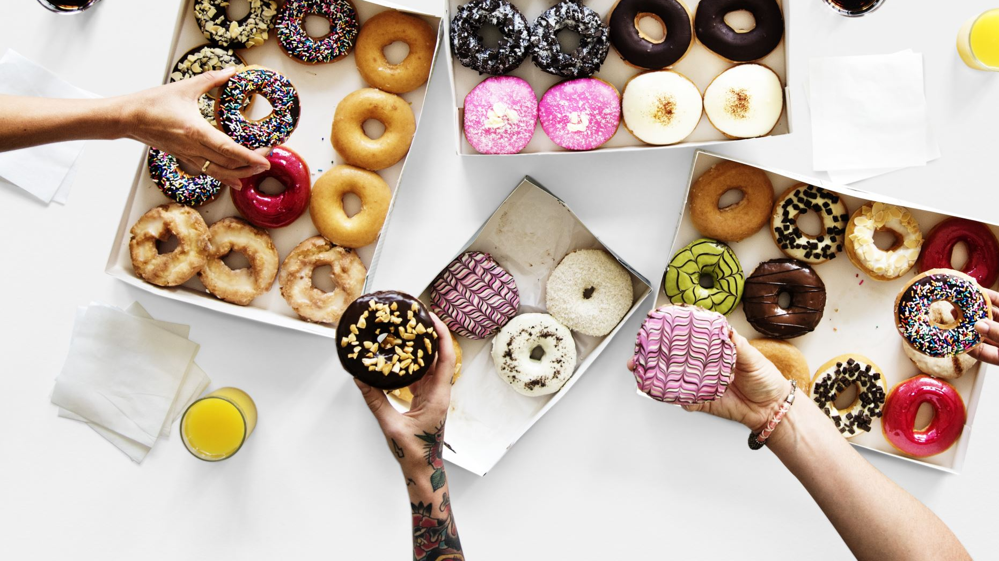
Combo, Offers and Recommendations

Slide 20
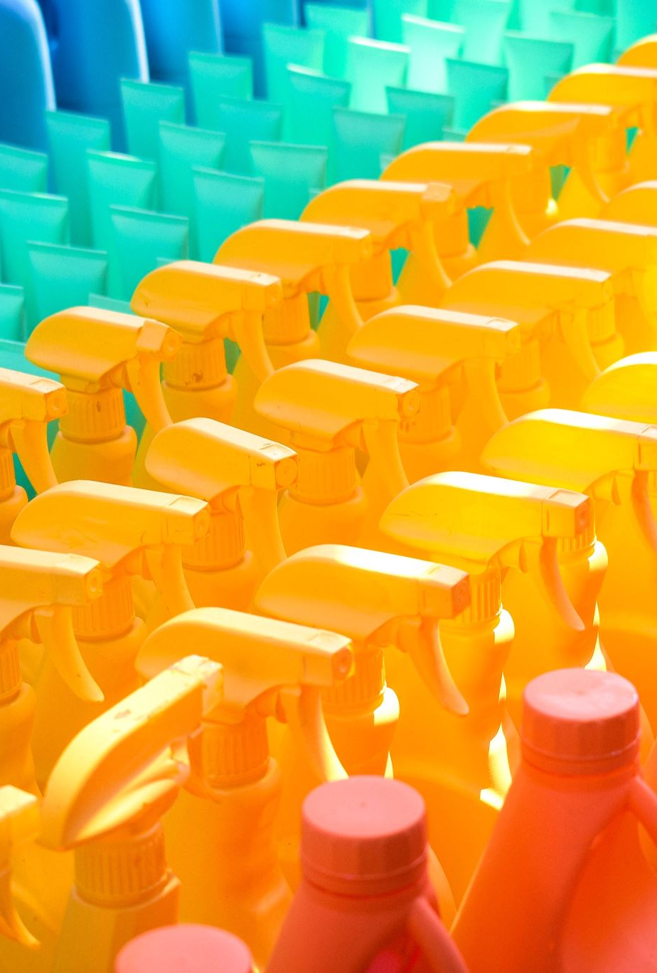
Recommendations:
The product volume of the grocery store is having an overall negative trend. This negative trend is further amplified by the onset of Covid-19 at the Q1 of 2020.
The store may try sending promotional offers to the customers on essential products like the soap, toilet paper, milk, laundry detergent, hand soap, cereal.
Giving promotional offers on these essential products may attract more customers and indirectly may help in the sales of associated products.
Sales in May has performed well in past 2 years, the store may have to stock the products highly sold in summer season like ice creams, soda, etc...
Buy 2 Get 1 free offer:
Buy 2 of any of these items [eggs, ice cream, pasta] for a free paper towel.
Buy 2 of any of these items [paper towels, eggs, ice cream] for one free pasta.
Buy 2 of any of these items [yogurt, toilet paper, aluminum foil] for one free juice.

Slide 21
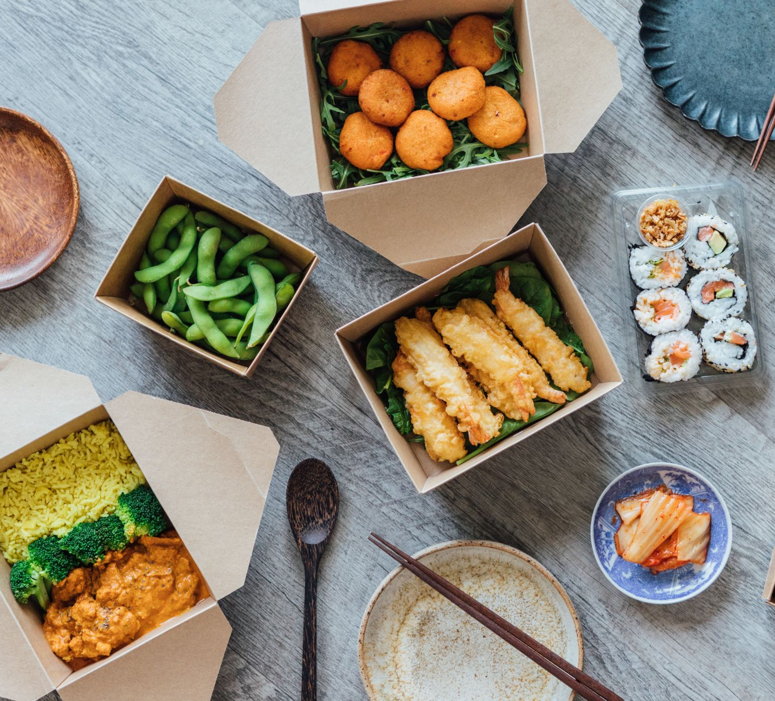
Combo offers for meals
The Grocery store can try this combo meal
Individual meals made with items like sandwich loaves, lunch meat.
Beef and eggs accompanied with a beverage like soda.
There is a 50% expectation for customers to buy the meal combo made with these items.

Slide 22
Tableau Public link:
Reference:
Associations Identified Excel:
MRA PROJECT - MILESTONE 2_R.BALASUBRAMANIYAM | Tableau Public

Slide 23

Thank you!

